Slide 1
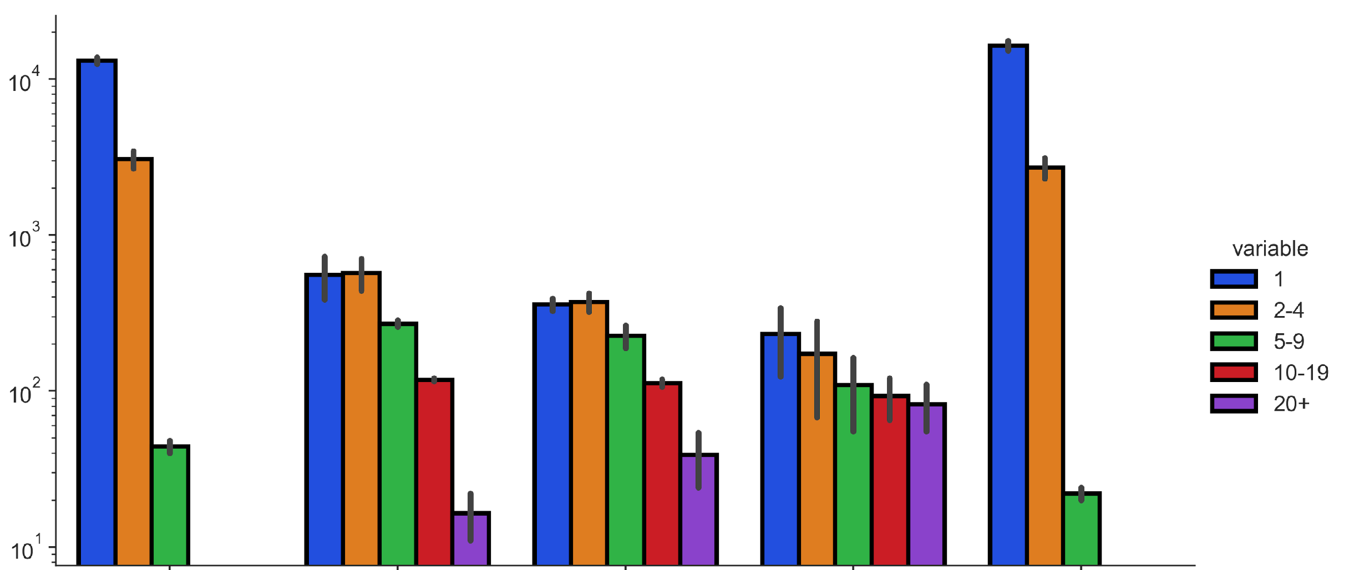
A
Read depth
UMI groups with p-m⁵C
MT-A
MT-B
MT-C
MT-D
MT RNAseq

Slide 2
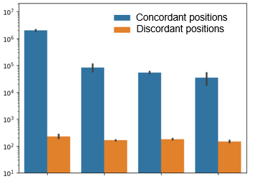
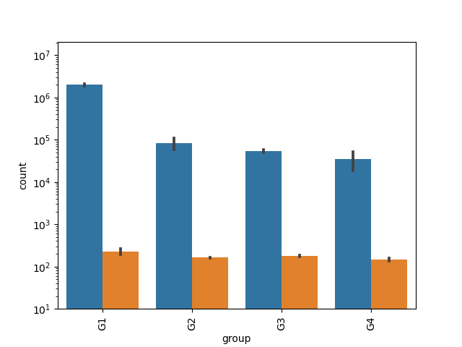
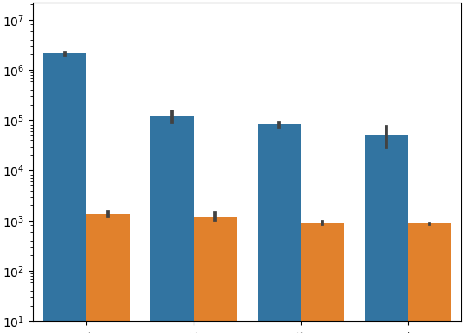
B
UMI groups with p-m⁵C
UMI groups with “T”
0.0001 | 0.003 | 0.004 | 0.007
0.0001 | 0.003 | 0.004 | 0.007
Number of Occurances
UMI groups with “G”
UMI groups with “A”
0.0001 | 0.003 | 0.004 | 0.008
0.0006 | 0.010 | 0.011 | 0.016

Slide 3
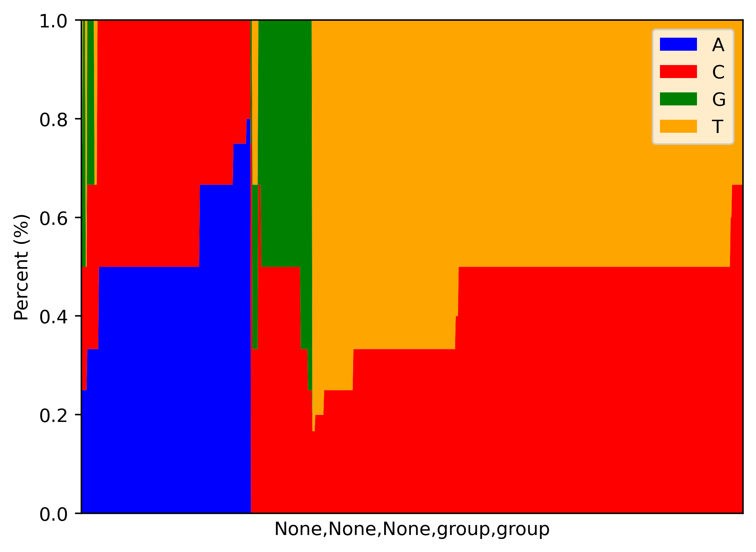
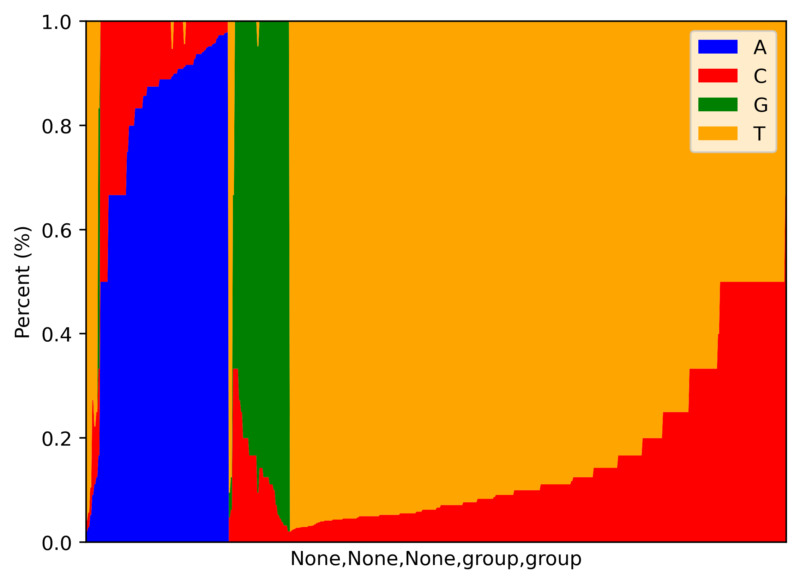

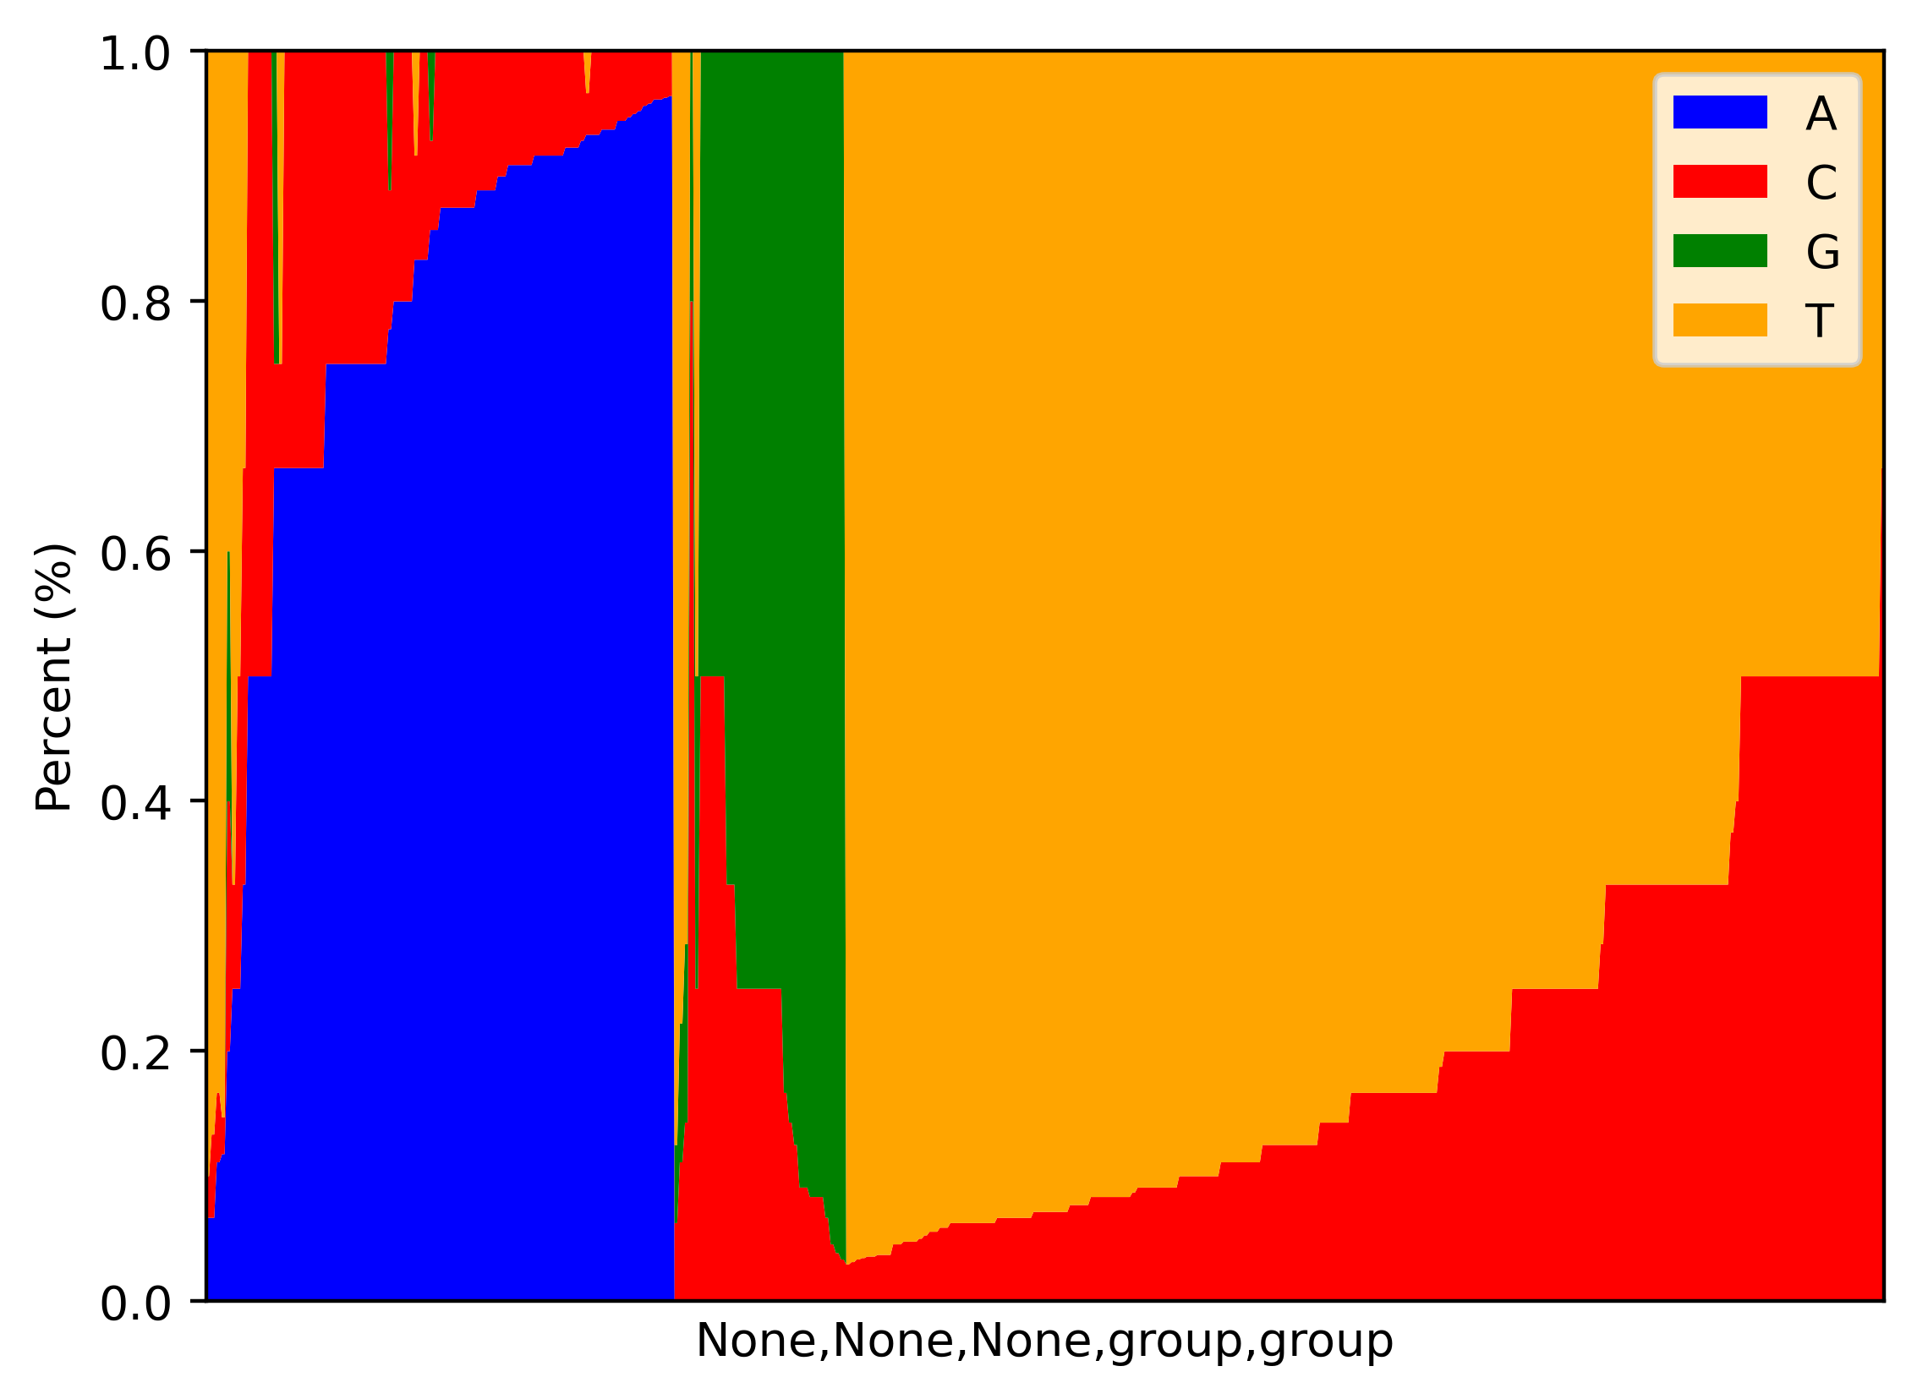
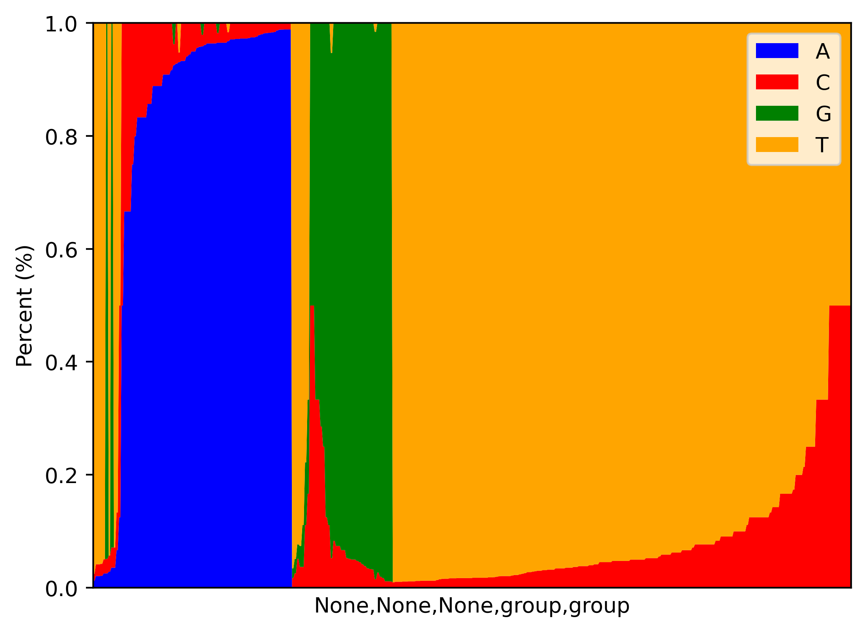
C
MT-A
MT-B
p-m⁵C site
1.0
0.8
0.6
0.4
0.2
0.0
1.0
0.8
0.6
0.4
0.2
0.0
A
T
G
C
Proportion
MT-C
MT-D
1.0
0.8
0.6
0.4
0.2
0.0
1.0
0.8
0.6
0.4
0.2
0.0

Slide 4
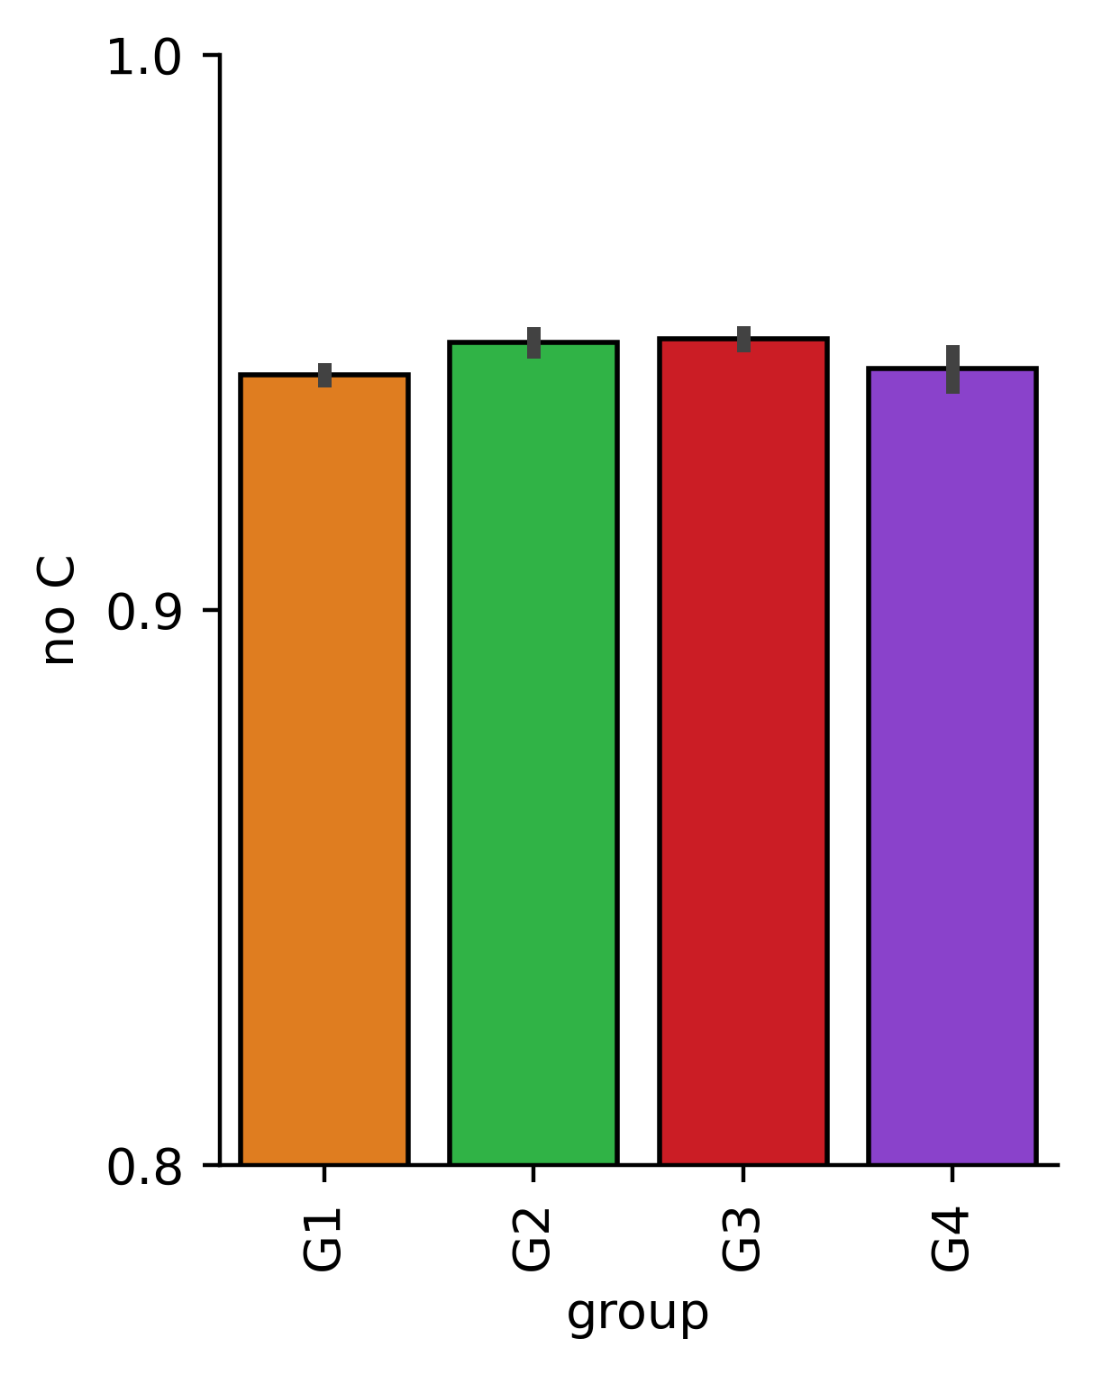
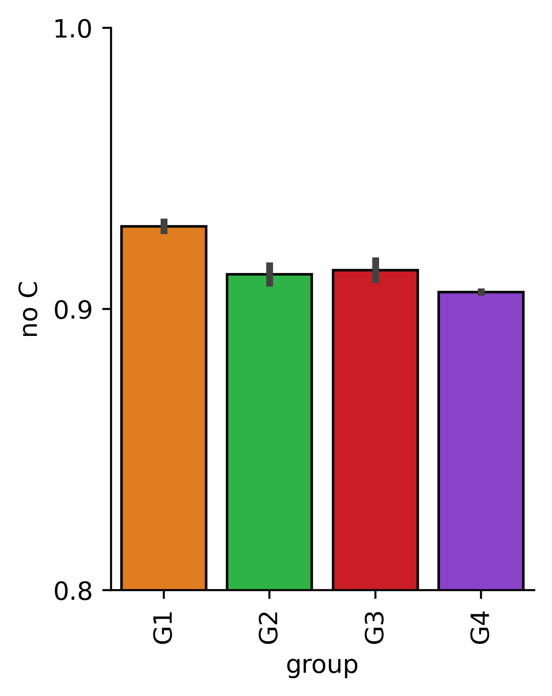
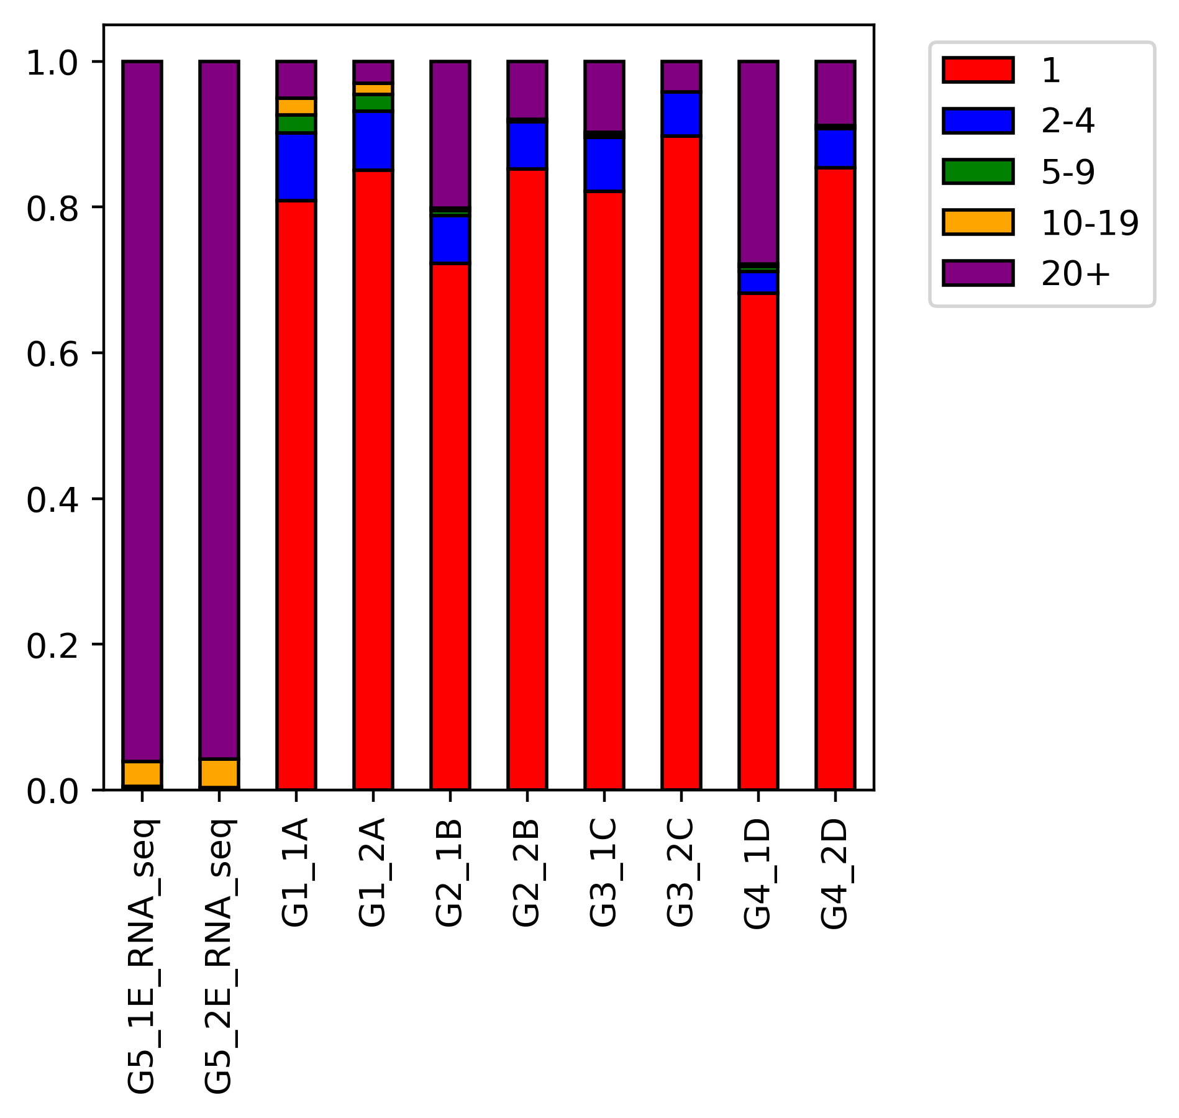
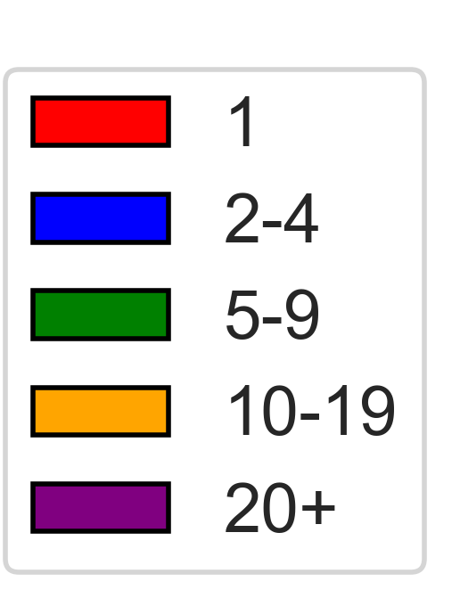
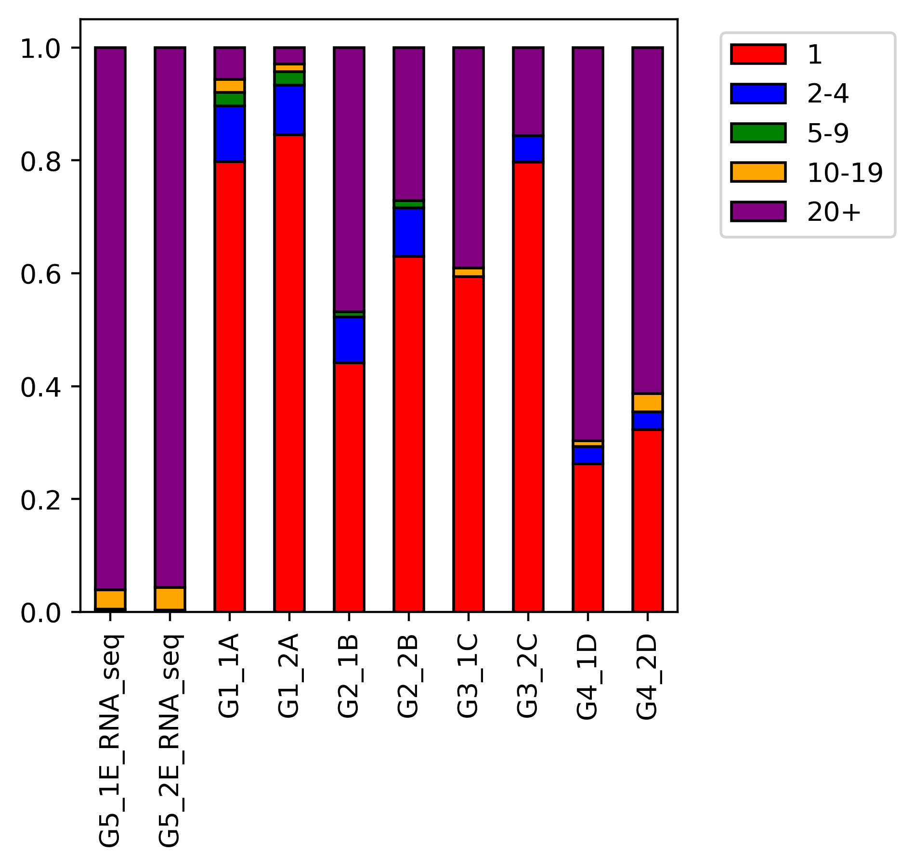
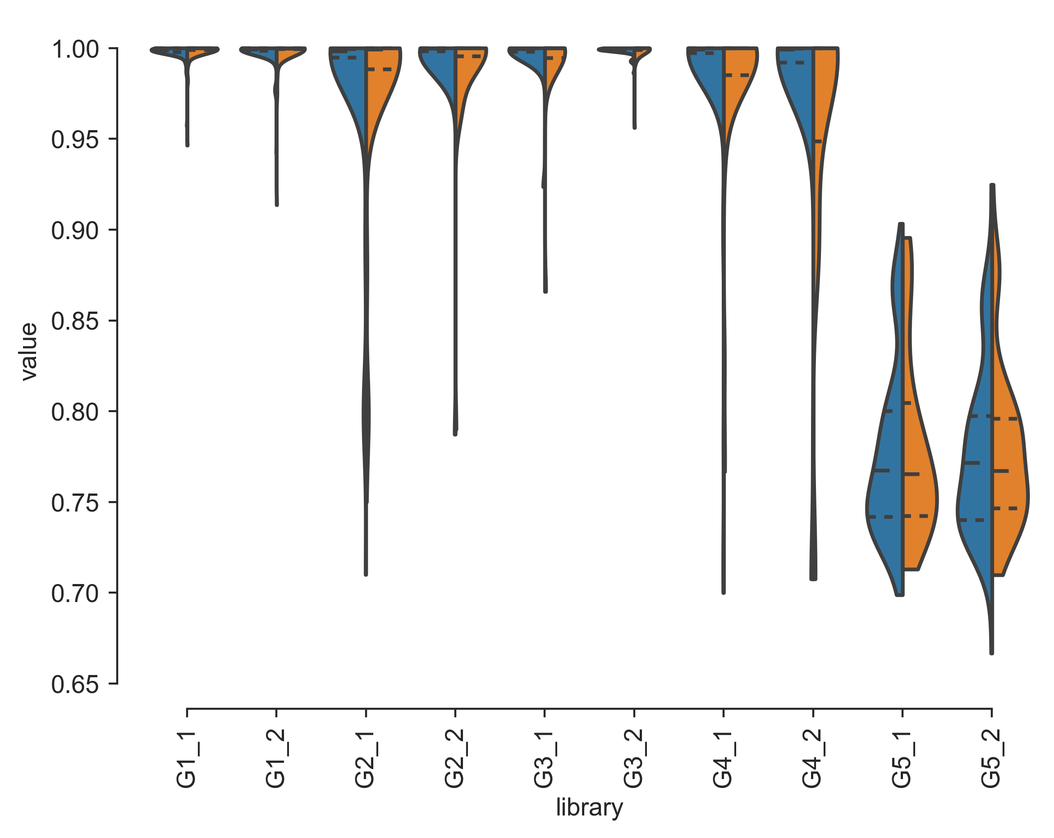
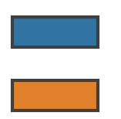
D
100
90
80
E
No deduplication
After deduplication
No deduplication
p-m⁵Cs per read
1.0
0.8
0.6
0.4
0.2
0.0
Reads without p-m⁵C (%)
Proportion of reads
MT-A
1.0
0.8
0.6
0.4
0.2
0.0
After deduplication
MT-B
MT-D
MT-B
MT-D
MT-C
MT-A
MT-C
F
Mean conversion rates:
Non-dedup |  | 0.998 | 0.997 | 0.991 | 0.991 | 0.993 | 0.997 | 0.995 | 0.979
Dedup |  | 0.998 | 0.997 | 0.976 | 0.989 | 0.992 | 0.998 | 0.983 | 0.958
1.0
0.9
0.8
0.7
Conversion rate of ERCCs
Non-dedup
Dedup
MT RNAseq
MT-A
MT-B
MT-C
MT-D
MT-A
MT-B
MT-C
MT-D

